Slide 1

In-Vehicle Coupon Recommendation: Optimizing Targeted Marketing
ISM 6136 - Data Mining Project
Group B

Slide 2

Group Members
Harsha Sai Jagu(U10209745)
Himanshu Sunil Srivastava (U79675891)
Poojitha Nadendla (U08878472)
Saumya Uttam (U74234095)

Slide 3
Agenda
Introduction
Problem Statement
Business Opportunities
Past work
Approach
Data Collection
Data Insights
Cost Aspect
Evaluation Metrics
Models Used
Numerical Outcomes
Comparison of Models Performance
Best Model
Conclusion
Recommendations

Slide 4
Introduction
"CouponsOnWheels" is a leading coupon distribution company that has been at the forefront of delivering exciting offers to a diverse range of drivers. With a rich history of marketing campaigns, they have successfully offered various coupons to drivers in different scenarios.
In their quest to continually innovate and optimize marketing strategies, "CouponsOnWheels" faced significant challenges. Their recent campaign, offering coupons in various driving scenarios, showed varying acceptance rates among drivers. This unpredictability led to increased marketing costs and inefficiencies in coupon distribution.

Slide 5
Problem Statement
CouponsOnWheels" is grappling with the challenge of distributing coupons effectively and efficiently to their diverse pool of drivers. They need to answer the fundamental question: "Which drivers are more likely to accept coupons?" This is essential to streamline their marketing efforts and cut down on unnecessary expenses.
The company's ultimate goal is to optimize their marketing strategies. They aim to reduce marketing costs significantly while maximizing the revenue generated through coupon campaigns. Achieving this balance is crucial for their long-term success and competitiveness in the market.

Slide 6
Business Opportunities
Business analytics offers immense opportunities to transform the way companies make decisions, especially in marketing and revenue optimization.
Opportunities for "CouponsOnWheels"
"CouponsOnWheels" can leverage business analytics to:
Improve marketing efficiency.
Optimize coupon distribution.
Maximize the return on investment.
Enhance customer satisfaction.
Gain a competitive edge.
Create accurate forecasts and develop strategic plans.

Slide 7
Past Work
The research paper titled “A Bayesian framework for learning rule sets for interpretable classification.’ published in The Journal of Machine Learning Research” introduced a Bayesian Rule Sets (BRS) algorithm for providing predictions.
The research explored on the development of interpretable classifiers, specifically focusing on rule-based models.

Slide 8
Our Approach
"CouponsOnWheels" initiated a pilot campaign, distributing coupons to a random sample of drivers. Among these drivers, some accepted the coupons, while others did not. These campaign results provide valuable data to develop predictive models that can identify drivers more likely to accept coupons.
Develop a predictive model to target drivers likely to accept coupons, minimizing costs, maximizing ROI, and enhancing customer satisfaction.
By achieving this, "CouponsOnWheels" aims to enhance its marketing strategies, streamline coupon distribution, and ultimately provide more relevant offers to its customers.

Slide 9
Data Collection
"CouponsOnWheels" collected the data via a survey on Amazon Mechanical Turk.
The survey describes different driving scenarios including the destination, current time, weather, passenger, etc., and then ask the person whether he will accept the coupon if he is the driver.
The campaign included a sample of 12,864 drivers, representing a diverse group of individuals with varying driving scenarios.
Among the sampled drivers, 7,210 drivers accepted the coupons, providing insights into driver behave.ior and preferences

Slide 10
Features Used
destination
passenger
weather
temperature
time
coupon
Expiration
gender
age
maritalStatus
has_children
education
Occupation
income
bar
Coffeehouse
CarryAway
Car
RestaurantLessThan20 -
Restaurant20To50 -
toCoupon_GEQ5min
toCoupon_GEQ15min
toCoupon_GEQ25min
direction_same
direction_opp
avg_revenue_per_month
distance_in_time

Slide 11
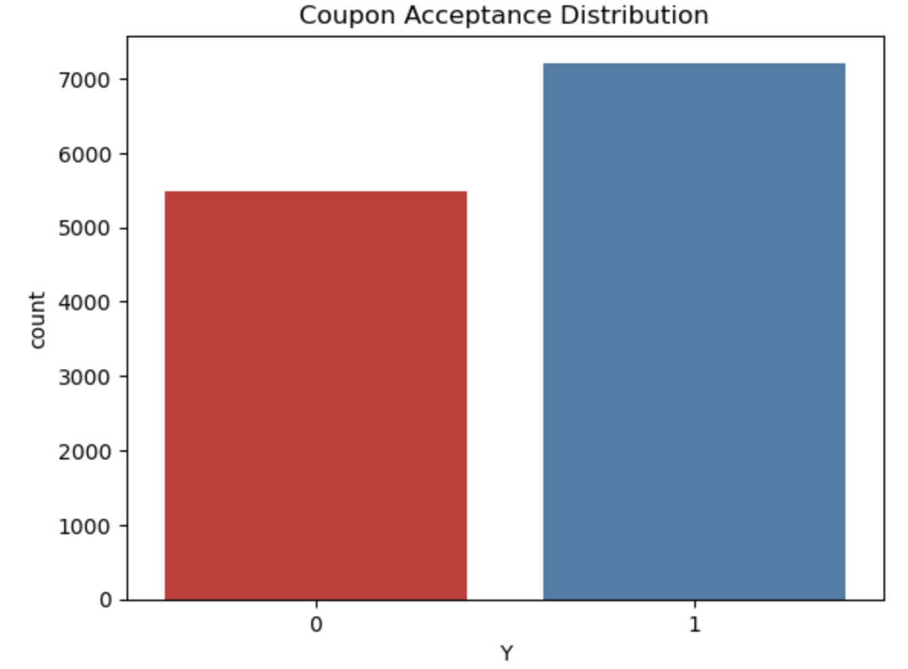
Target Variable
y - has the driver accepted the coupon(Binary: 1=Yes; 0=No)

Slide 12
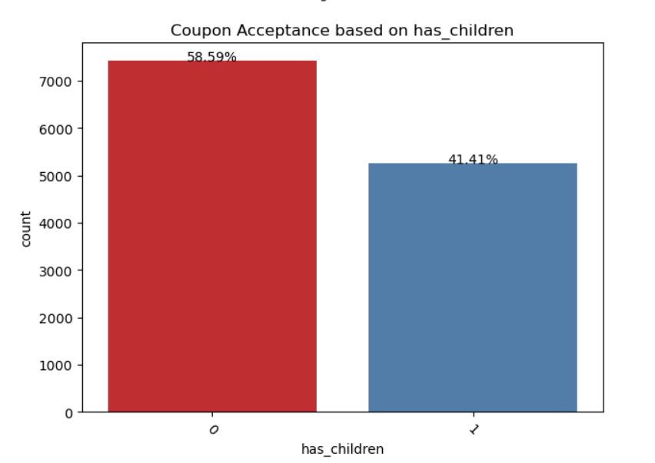
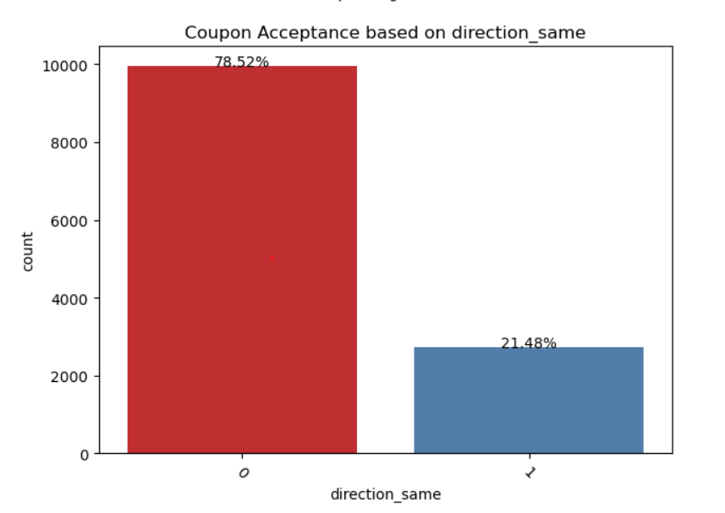
Data Insights

Slide 13
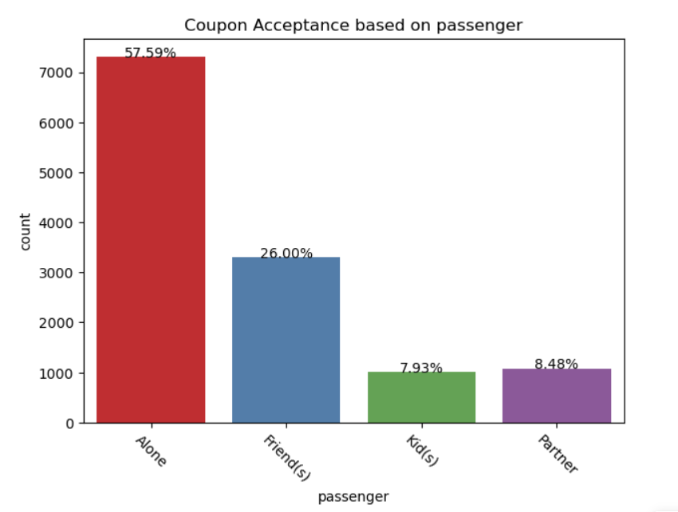
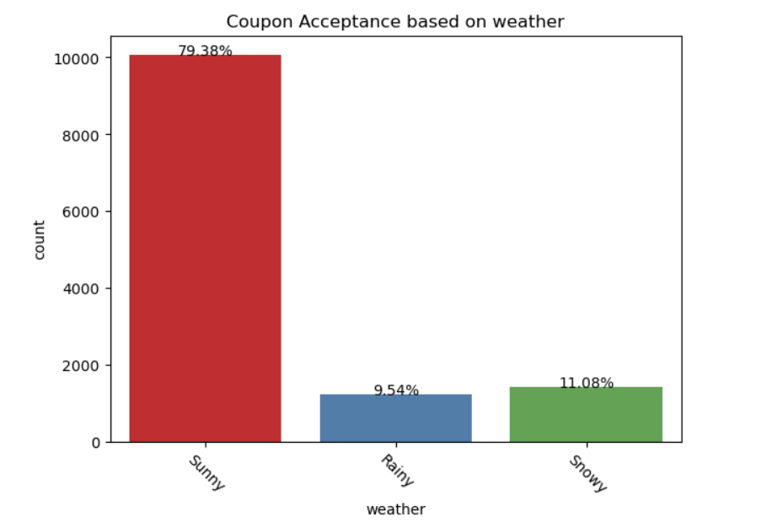
Data Insights

Slide 14
The Cost Aspect
"CouponsOnWheels" incurs a cost of $10 for each coupon promotion. On the other hand, they earn a profit of $100 for each driver who accepts the coupon. It's crucial to consider these financial factors when developing the predictive model.
The primary challenge lies in finding a balance between reducing marketing costs and maximizing revenue. "CouponsOnWheels" incurs costs with each coupon promotion, and they earn revenue for each driver who accepts the coupon. It's essential to optimize this balance to enhance customer satisfaction and profitability.

Slide 15
Evaluation Metrics
We have chosen "Net Profit" as the primary evaluation metric. Net Profit directly measures the financial success of marketing efforts.
Components of Net Profit
TP Profit: $100 (Profit from accepted coupons) - $10 (Cost of targeting) = $90
TN Profit: $10 (No acceptance, and no targeting cost)
FP Cost: $10 (No acceptance profit, just the targeting cost)
FN Cost: $100 (Missed acceptance profit) - $10 (Cost not incurred due to non-targeting) = $90
Net Profit = (Total Profit from True Positives) + (Total Profit from True Negatives) - (Total Cost of False Positives) - (Total Cost of False Negatives)

Slide 16
Evaluation Metrics
Balancing Precision and Recall
The key is to optimize the balance between high precision (minimizing false positives) and high recall (maximizing true positives) to maximize the Net Profit.
F1 Score as a Secondary Metric
While Net Profit is the primary focus, we also monitor precision and recall, with the F1 Score ensuring that marketing strategies strike the right balance.
Achieving Financially Rewarding Marketing Efforts
By selecting Net Profit as the primary evaluation metric, we align with the business goal of minimizing marketing costs and maximizing revenue, ultimately ensuring that our marketing strategies are financially rewarding.

Slide 17
Models Used
Decision Tree Model
XGBoost Model
LightGBM Model
Random Forest Model
Logistic Regression Model
We have added hyperparameter tuning on each of the above models for the best parameters using RandomSearchCV and GridSearchCV and 5 fold cross-validation.

Slide 18
Numerical Outcomes
Models | Accuracy | Recall | Precision | F1-Score | AUC | Profit
Decision Tree | 0.6908 | 0.8020 | 0.6976 | 0.7462 | 0.7361 | 1560168.0
Random Forest | 0.7189 | 0.8192 | 0.7221 | 0.7676 | 0.7840 | 1666053.0
XGBoost | 0.6671 | 0.9054 | 0.6475 | 0.7550 | 0.7371 | 2005254.0
LightGBM | 0.7404 | 0.8155 | 0.7488 | 0.7807 | 0.8026 | 1670782.0
Logistic Regression | 0.6689 | 0.7417 | 0.6877 | 0.7228 | 0.7193 | 1355491.0

Slide 19
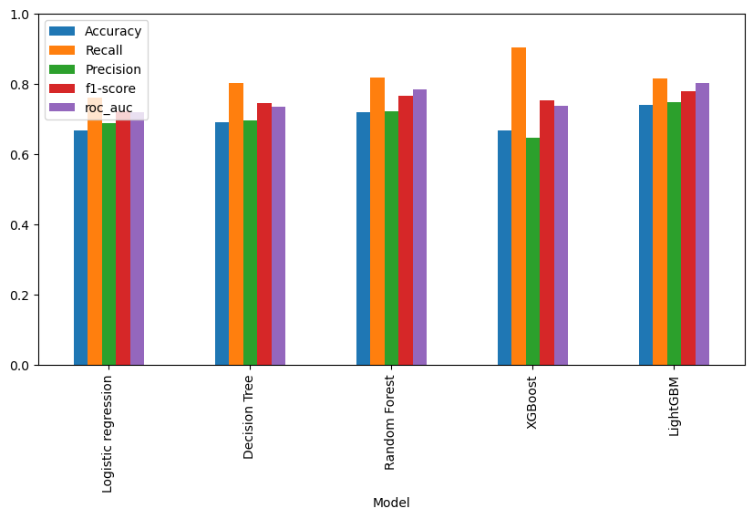
Comparison of all Models’ Performance

Slide 20
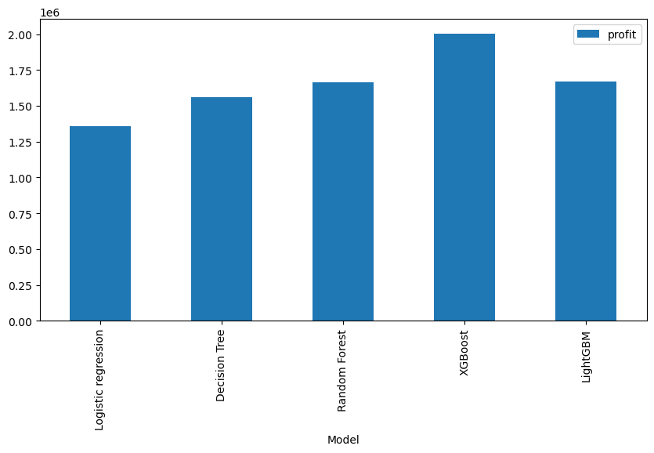
Comparison of all Models’ Performance -Profit

Slide 21
Best Model
Based on the chosen evaluation metric, Net Profit, the XGBoost model stands out as the top-performing model, generating the highest net profit of $2,005,254. This model excels in capturing a significant number of potential coupon acceptors with the highest recall rate of 90.54%.
The LightGBM model also delivers strong performance, with a competitive accuracy of 74.04% and an impressive recall rate of 81.55%. Its net profit of $1,670,782 makes it a solid choice for maximizing revenue while maintaining a strong balance between precision and recall.

Slide 22
Conclusion
Net Profit:
XGBoost > LightGBM > Random Forest > Decision Tree > Logistic Regression
F1- Score:
LightGBM > Random Forest > XGBoost > Decision Tree > Logistic Regression

Slide 23
Conclusion
The selection of the model for predicting coupon acceptance depends on the specific objectives and resource constraints of the marketing campaign.
The XGBoost model, with its high recall and maximum net profit, is a preferred choice for organizations prioritizing the capture of potential coupon acceptors, even with some false positives. However, organizations with different priorities may consider the strengths of other models, such as LightGBM or Random Forest, to meet their unique business goals.

Slide 24
Recommendations for Moving Forward
Future Directions
Our predictive model opens the door to further enhancements in coupon distribution and marketing strategies.
Continuous monitoring and adaptation of the model will ensure sustained success.
A Journey of Optimization
The project is not a destination but a journey of ongoing optimization in maximizing ROI and customer satisfaction.

Slide 25

Your voice matters!!
Welcoming your Questions and Clarifications!

Slide 26
Thank You!

